Slide 1
Open Access Training:
NMR Service
Dr Coral Mycroft
NMR Service Manager

Slide 2
NMR Facility – 4 Levels Of Analysis
Open Access
  Walk up use at any time of the day
  Common 1D/2D experiments: ¹H, ¹³C, ¹⁹F, ³¹P, DEPTq, COSY, HSQC, HMBC*, NOESY*
  Fast turnover and hence rapid sample throughput
  Ground/first floors: Organic
  Second floor: Inorganic
NMR Service
  A submission service where researchers may submit samples for the NMR staff to run on the basement instruments.
Hands on
  Users can book the basement systems for manual/automated operation
Research Projects
  Collaborative projects involving the NMR staff/group
*Currently trialling experiments

Slide 3
A Typical Procedure Of Analysing A Sample Using NMR
Check the sample quality
  Open-access spectrometers to collect a basic 1D ¹H NMR spectrum
  Check structure corresponds to what you expect, as well as the integrity and quality of the sample
Collect further data
  Open-access spectrometers to characterise the molecules: 1D and 2D spectra
  Always assess the ¹H NMR spectrum first
Further experiments (if necessary)
  If the data collected is insufficient, you can consider submitting the sample to the NMR service / use the hands-on instruments (if trained)

Slide 4
Why Use The NMR Service?
Availability of experiments
  Other nuclei: ²H, ⁷Li, ¹¹B, ²⁷Al, ¹¹⁹Sn etc.
  2D experiments: TOCSY, H2BC, ROESY, ¹H-¹⁵N HSQC/HMBC
  More specialised experiments: Diffusion (DOSY), variable temperature, pure shift, selective and more
Dilute samples
  Walk-up instruments do not allow you to adjust any experiment parameters
  The NMR service will adjust experiment parameters so acceptable spectra is obtained.
Higher field spectrometers
  500 – 700 MHz
Solid state samples

Slide 5
Seven Steps To Use The NMR Service for Solution-State NMR
(solid-state mentioned later)

Slide 6
Step 1: NMR Sample Preparation
Sample Tubes
  5 mm high-quality tubes: Norell 400S, Wilmad 507-PP, or New Era MP5 at least
  Cracked, scratched, short or broken tubes will not be accepted
Solvents
  Use a deuterated solvent
  Solvent depth for 5mm tubes should be between 4.0 - 4.5 cm (500 - 600 μL)
Quantity of sample
  ¹H / ¹⁹F: 1-10 mg for the 600 MHz
  ¹³C: At least 10+ mg for the 600 MHz (ca. 50+ mg should be run on the 400s)
  ³¹P: 10 mg
Labelling of NMR tube
  Use the correct NMR cap colour
  Label cap/tube with initials, solvent and group

Slide 7
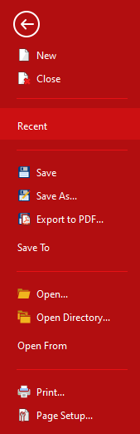
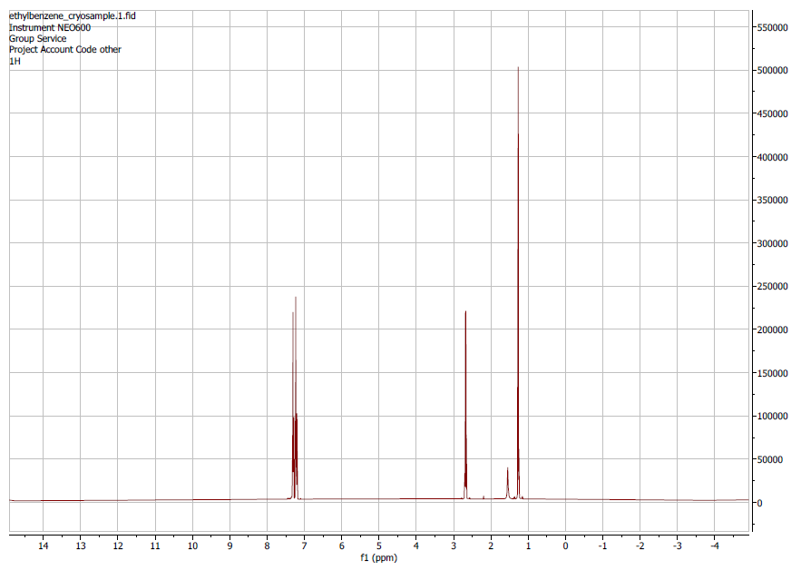
Step 2: Acquire A ¹H NMR And Convert Spectrum To A PDF.
Spectrum information
Top of the most intense signal can be seen
Full range of signals

Slide 8
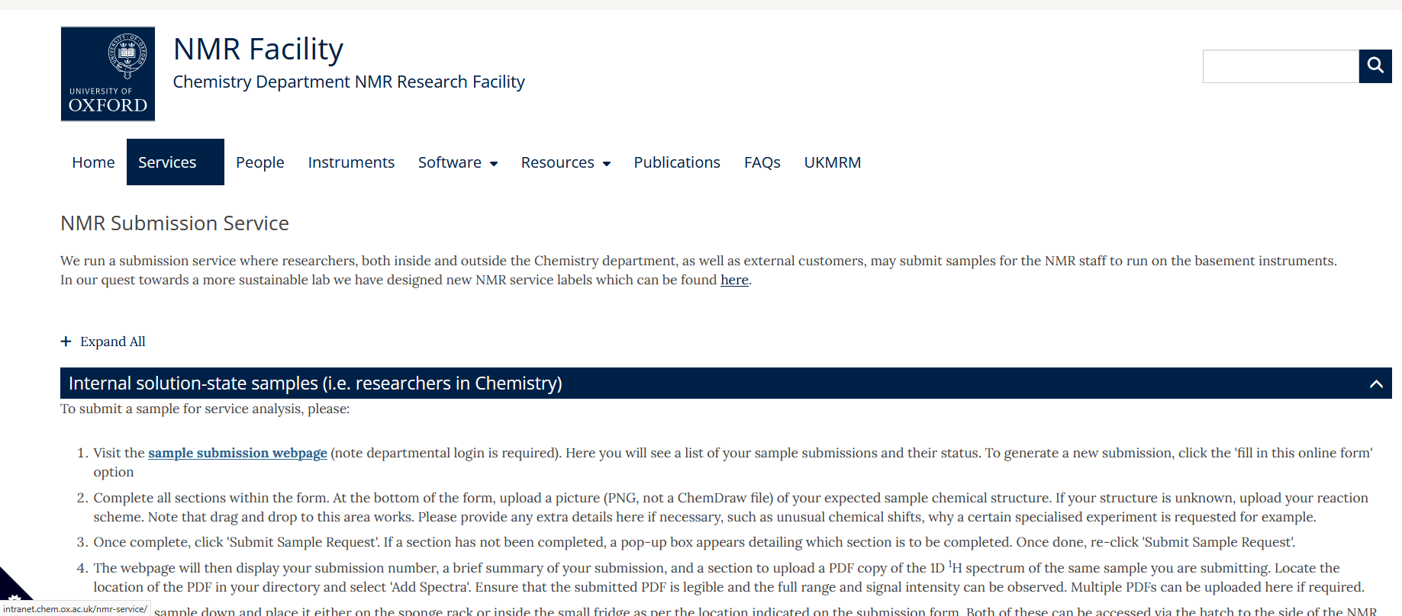
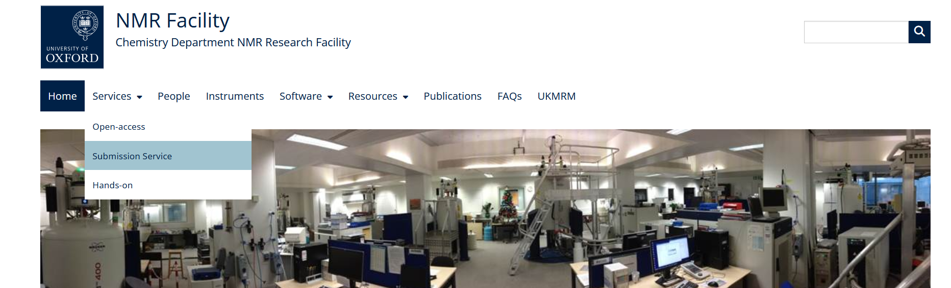
Step 3: Go to sample submission website
https://intranet.chem.ox.ac.uk/nmr-service/

Slide 9
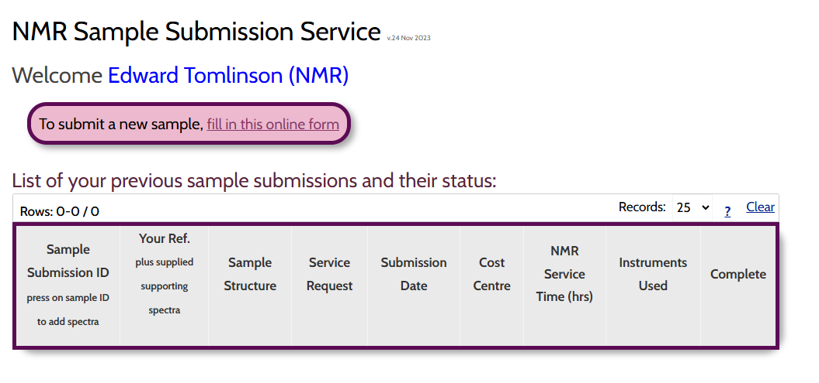
Step 3: Go to sample submission website

Slide 10
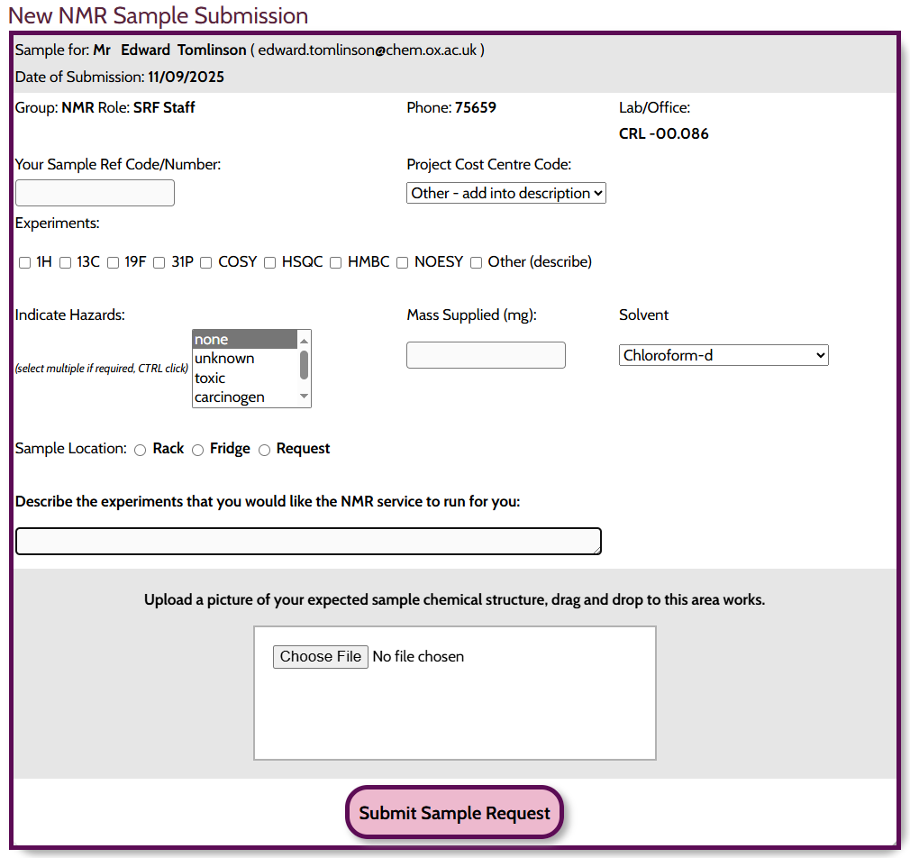
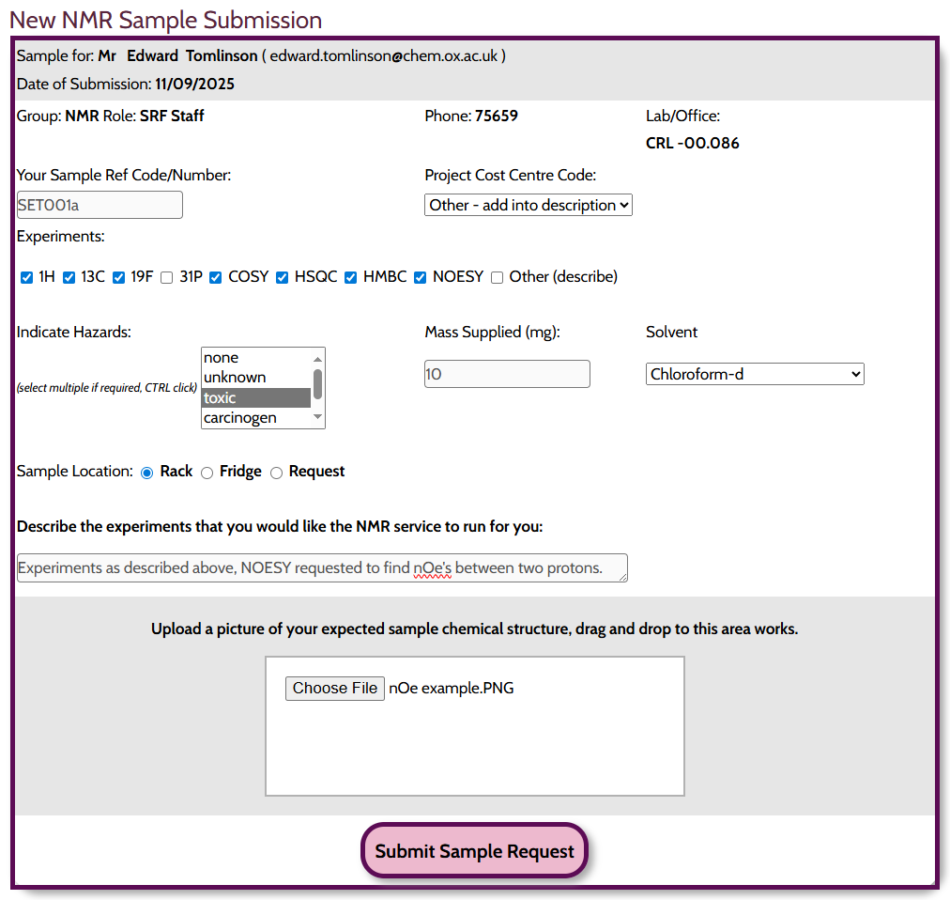
Step 4: Fill out relevant information

Slide 11
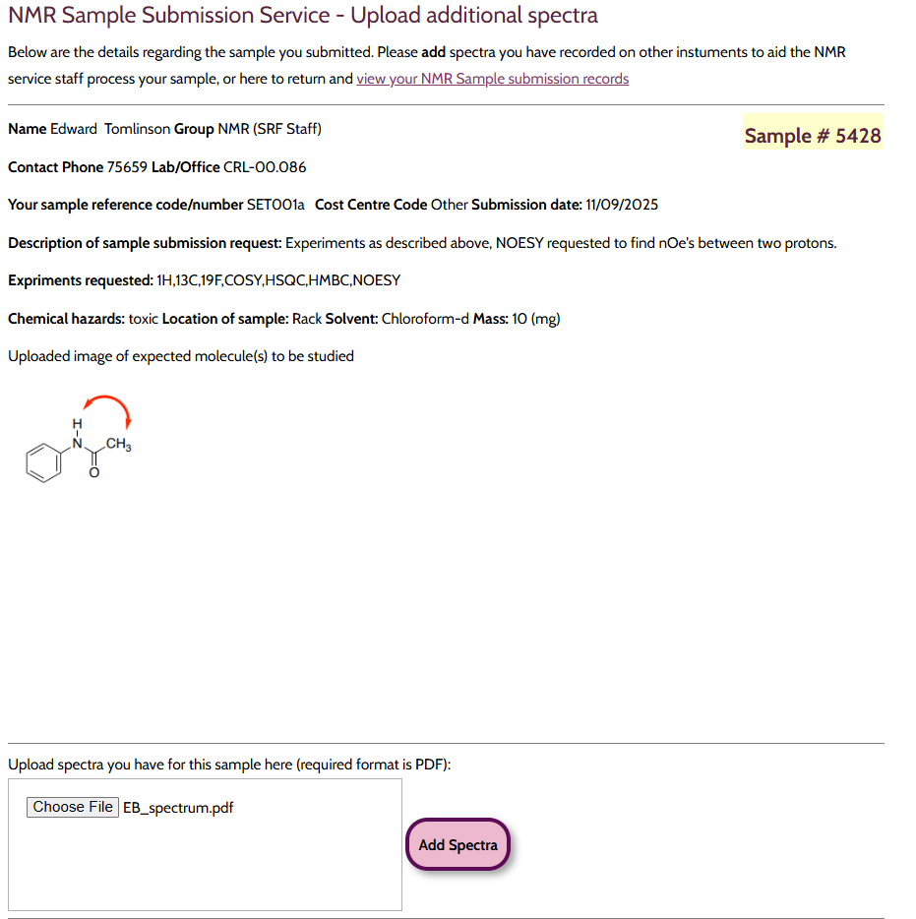
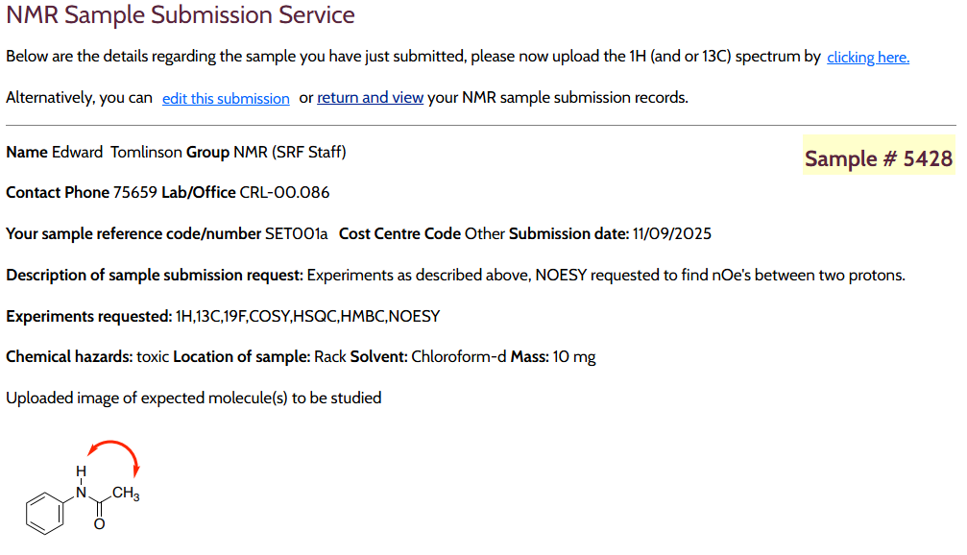
Step 5: Add 1H spectrum
Please make sure you click to add

Slide 12
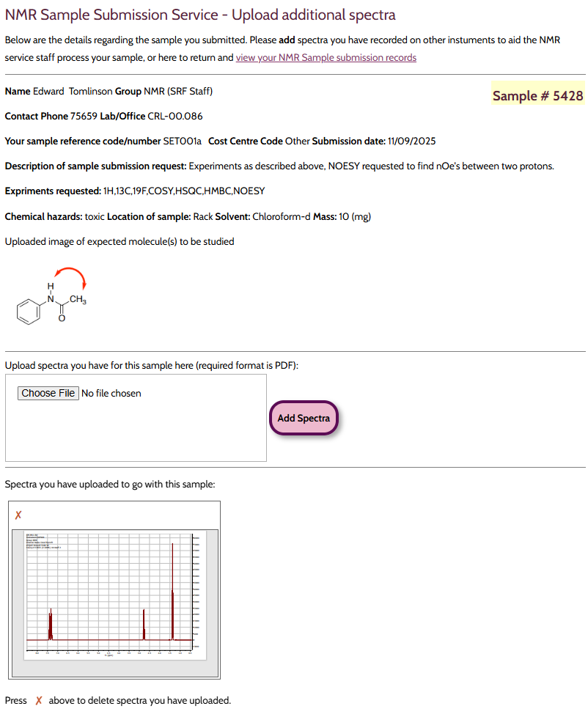
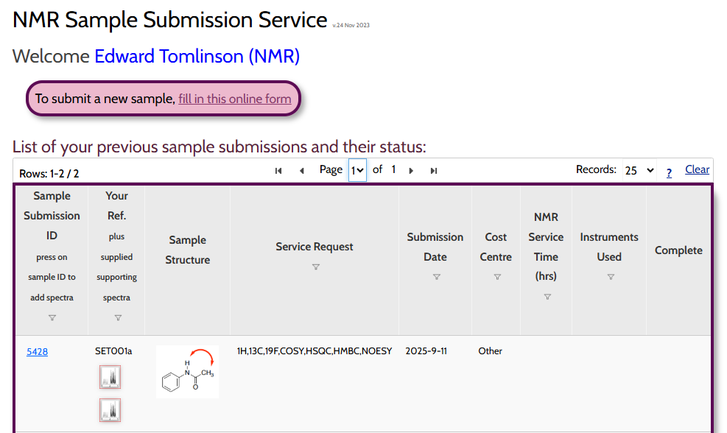
Step 6: View your submission
Click

Slide 13
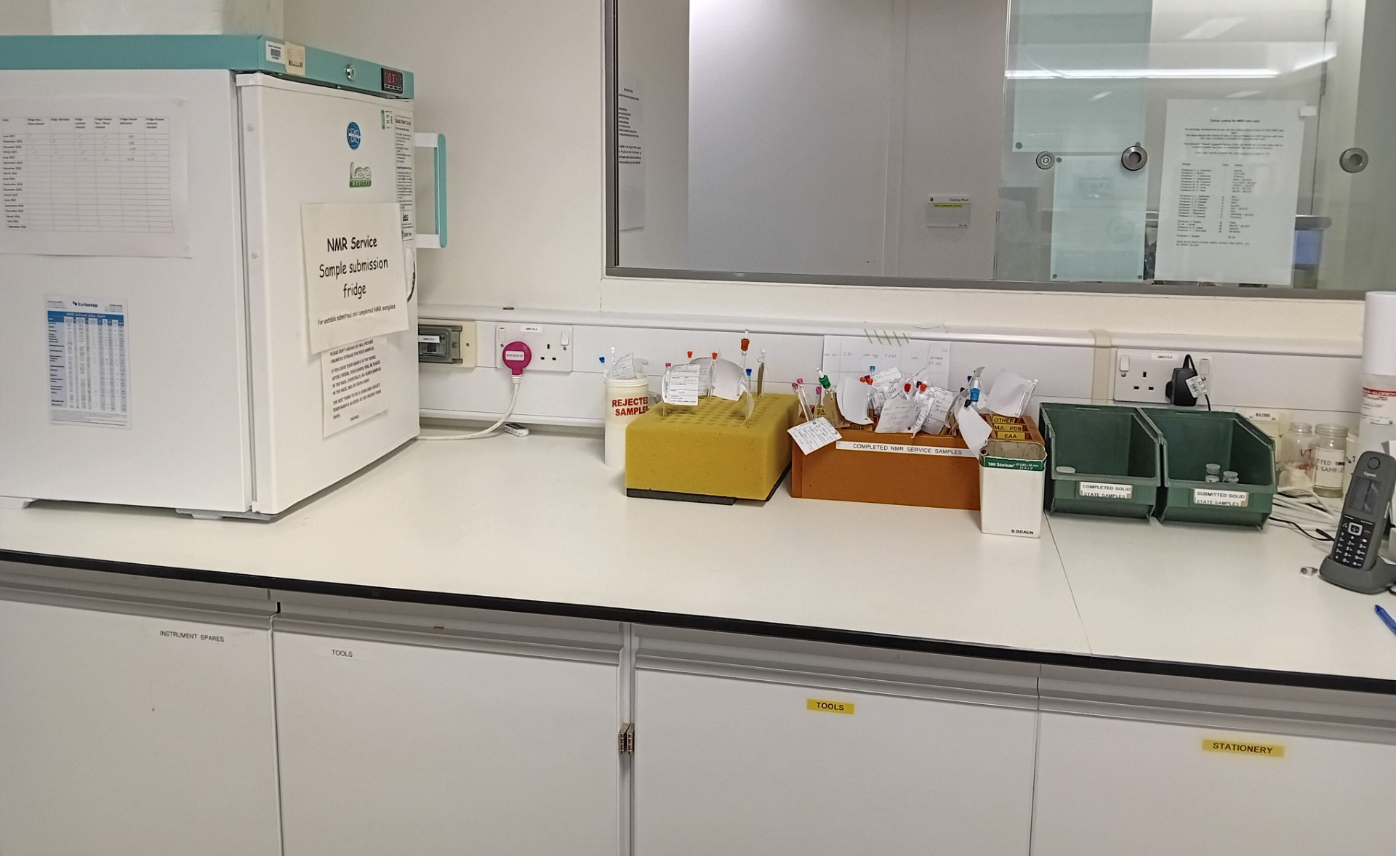
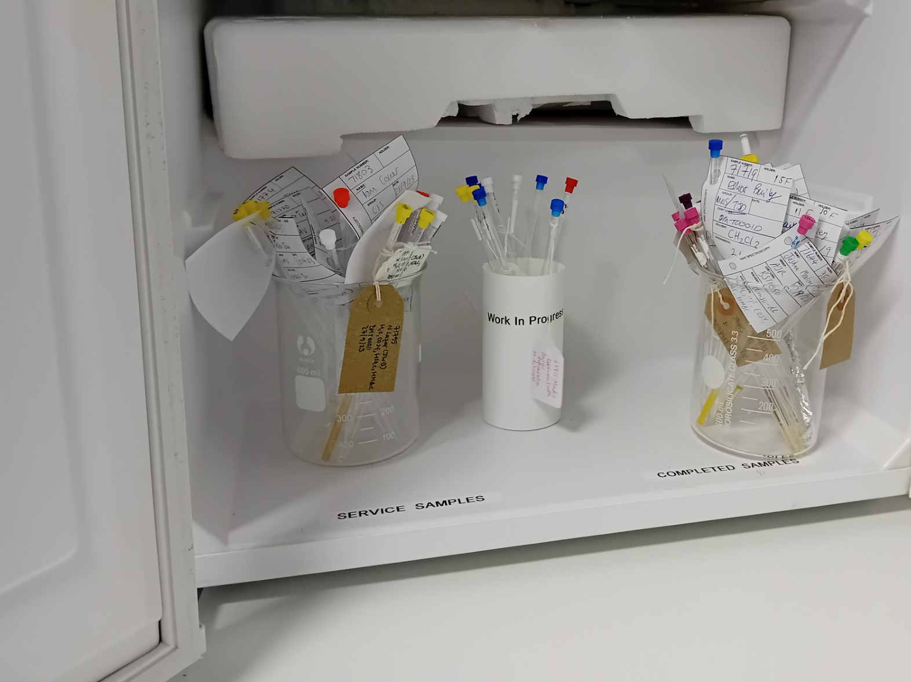
Step 7: Bring The NMR Sample Down To The Basement With A Completed Label
Solution-state incoming and completed
Solid state incoming and completed

Slide 14
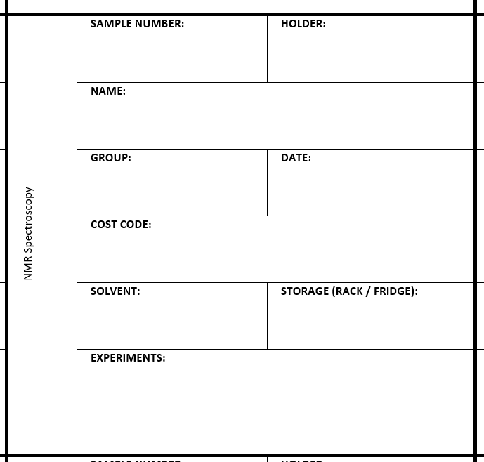
Step 7: Bring The NMR Sample Down To The Basement With A Completed Label
5428
FOR NMR SERVICE ONLY – LEAVE BLANK
Edward Tomlinson
HLA/ HB/ SJC
11/09/2025
DMT12345
CDCl₃
Rack
¹H, ¹³C, COSY, HSQC, HMBC, NOESY

Slide 15
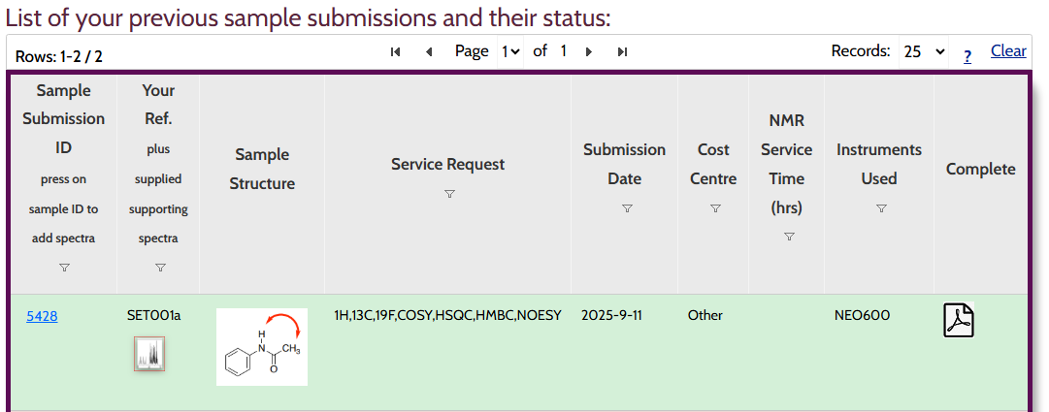
Next Steps: NMR Facility Staff Take Over
The NMR facility will check the sample, paperwork and PDF of the submitted sample
  Everything is correct: schedule the analysis
  Issue with sample/paperwork/PDF: analysis will not be scheduled
Turnover is dependent on the current demand of the NMR Service and the analysis requested
Once complete, the status on the submission webpage is updated to Green, with details of which spectrometer was used to run the sample
Click here to see a report regarding your sample

Slide 16
Next Steps: NMR Facility Staff Take Over
At this point you can obtain the data from the NMR data server. This data is organised by instrument and then by your research group initials. Each individual dataset is then named according to the following:
The sample will be placed in the returns rack/fridge (solution) or completed tub (solid)
<initials> <five-digit submission number> <date in DDMM format>
et54281109

Slide 17
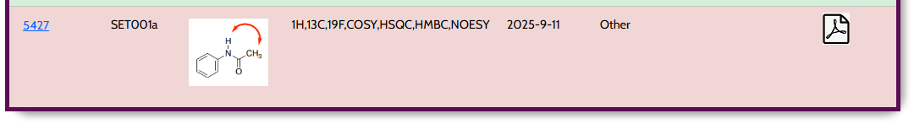
Why Hasn’t My Sample Been Run?
Check the submission system
If no information, the sample has yet to be run
  Service is very busy
  Analysis requires a specific spectrometer
If system says aborted, either an element of the paperwork or sample is incorrect
  Correct the error and re-submit the sample/paperwork
  Depending on how busy the service is, we may email you stating what is incorrect for you to fix
If it’s been >1 week and you’ve requested only conventional 1D and 2D experiments, you can email us: nmrstaff@maillist.chem.ox.ac.uk

Slide 18
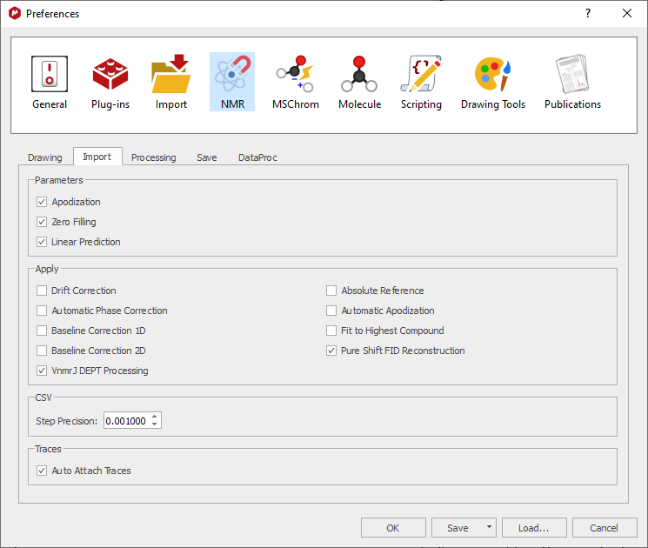
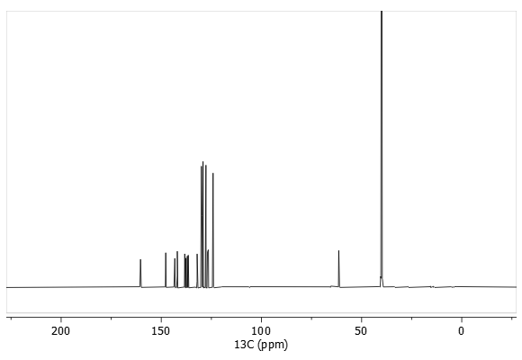
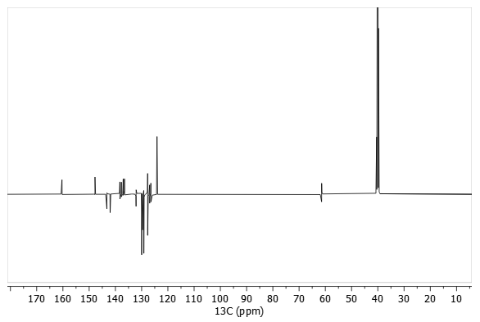
13C spectra run on the NEO600
Any ¹³C spectra on the NEO600 will require minor changes in your MestreNova settings.

Slide 19
Six Steps To Use The NMR Service for Solid-State NMR
1. Consult Nick Rees before submitting samples
  Nick.rees@chem.ox.ac.uk
2. Prepare the NMR sample
  Stable samples provided as a solid (c.a. 200 mg)
  Unstable samples can be packed in a glove box
3. Generate a unique submission Number via the NMR Facility Website
4. Complete submission form
5. Place submission form in the Solid-State submission folder on the Q drive
6. Stable samples should be placed in the box through the basement NMR lab hatch
https://nmrchem.web.ox.ac.uk/

Slide 20

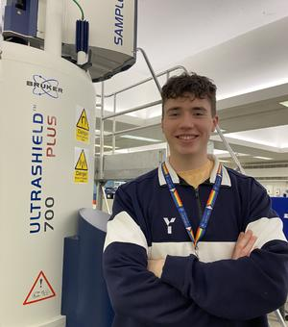
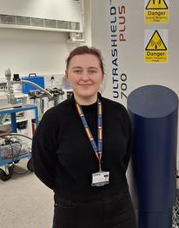

NMR Facility Members
nmrstaff@maillist.chem.ox.ac.uk
Nick
Edward
Coral
Harry
Head of inorganic NMR
NMR Research Technician
NMR Service Manager
Head of organic NMR

Slide 21
Training And Other
Providing you have registered, you are now trained to the open access NMR spectrometers on the relevant floors
  Ground/first floors: Organic
  Second floor: Inorganic
Use of the basement spectrometers in ‘hands on’ mode?
  Requires a separate 60-90 minute training
  Part 2 users are not allowed, unless their project has a significant NMR element
Slides for the NMR Introductory lecture and NMR Service are available on the NMR Facility homepage
Talk to us in person, or contact the NMR staff mail list for all enquiries.
nmrstaff@maillist.chem.ox.ac.uk

